Slide 1
Module 2 – Hadoop HDFS and Map reduce
Beyond Hadoop Ecosystem…

Slide 2
Core Components of HADOOP

Slide 3
Hadoop Core Component 1
HDFS
A file system designed to store large amounts of data across multiple nodes of commodity hardware.
HDFS has a master–slave architecture made up of data nodes which each store blocks of the data, retrieve data on demand, and report back to the name node with inventory.
The name node keeps records of this inventory (references to file locations and metadata) and directs traffic to the data nodes upon client requests.
This system has built-in fault tolerance, typically keeping three or more copies of each data block in case of disk failure.

Slide 4
High Level Hadoop Architecture

Slide 5
Hadoop Distributed File System

Slide 6
Physical Architecture of Hadoop

Slide 7
Map Reduce

Slide 8
Hadoop Core Component 2
MapReduce Data processing engine:
A MapReduce job consists of two parts, a map phase, which takes raw data and organizes it into key/value pairs, and a reduce phase which processes data in parallel.
Hadoop MapReduce is a software framework for easily writing applications which process vast amounts of data in-parallel on large clusters ( thousands of nodes) of commodity hardware in a reliable, fault tolerant manner.

Slide 9
MapReduce (Hadoop’s computation engine)

Slide 10
Map Reduce Overview
Sequentially read a lot of data
Map:
Extract something you care about
Group by key: Sort and Shuffle
Reduce:
Aggregate, summarize, filter or transform
Write the result

Slide 11
Schematic of Map Reduce computation

Slide 12
Map-Reduce
Programmer specifies:
Map and Reduce and input files
Workflow:
Read inputs as a set of key-value-pairs
Map transforms input kv-pairs into a new set of k'v'-pairs
Sorts & Shuffles the k'v'-pairs to output nodes
All k’v’-pairs with a given k’ are sent to the same reduce
Reduce processes all k'v'-pairs grouped by key into new k''v''-pairs
Write the resulting pairs to files
All phases are distributed with many tasks doing the work
Input 0
Input 1
Input 2
Map 0
Map 1
Map 2
Shuffle
Reduce 0
Reduce 1
Out 0
Out 1

Slide 13
Data Flow
Input and final output are stored on a distributed file system (FS):
Scheduler tries to schedule map tasks “close” to physical storage location of input data
Intermediate results are stored on local FS of Map and Reduce workers
Output is often input to another MapReduce task

Slide 14
Map Reduce: Step 1 – Map phase
Intermediate
key-value pairs
Input
key-value pairs
k
v
map
k
v
k
v
map
k
v
k
v
…
…
k
v
k
v

Slide 15
Map Reduce: Step 2 – Grouping and Reduce phase
Output
key-value pairs
Intermediate
key-value pairs
Key-value groups
reduce
k
v
k
v
v
v
k
v
Group
by key
reduce
k
v
k
v
v
k
v
k
v
…
…
…
k
v
k
v
k
v

Slide 16
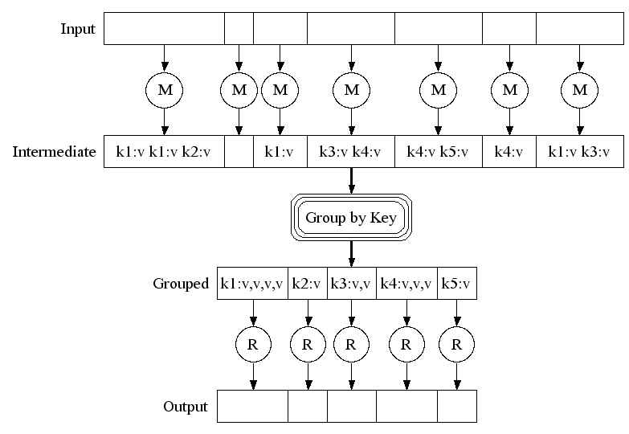
Map-Reduce: A diagram
Big document
MAP:
Read input and produces a set of key-value pairs
Group by key:
Collect all pairs with same key
(Hash merge, Shuffle, Sort, Partition)
Reduce:
Collect all values belonging to the key and output

Slide 17
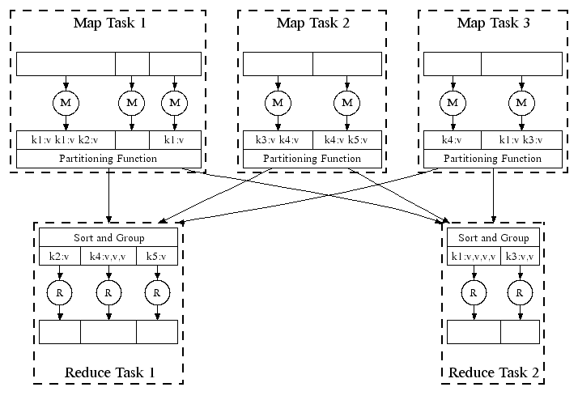
Map-Reduce: In Parallel
All phases are distributed with many tasks doing the work

Slide 18
Example: Word count using Map Reduce
map(key, value):
// key: document name; value: text of the document
for each word w in value:
emit(w, 1)
reduce(key, values):
// key: a word; value: an iterator over counts
result = 0
for each count v in values:
result += v
emit(key, result)

Slide 19
Working of Word Count
Provided by the programmer
Provided by the programmer
MAP:
Read input and produces a set of key-value pairs
Group by key:
Collect all pairs with same key
Reduce:
Collect all values belonging to the key and output
The crew of the space shuttle Endeavor recently returned to Earth as ambassadors, harbingers of a new era of space exploration. Scientists at NASA are saying that the recent assembly of the Dextre bot is the first step in a long-term space-based man/mache partnership. '"The work we're doing now -- the robotics we're doing -- is what we're going to need ……………………..
(The, 1)
(crew, 1)
(of, 1)
(the, 1)
(space, 1)
(shuttle, 1)
(Endeavor, 1)
(recently, 1)
….
(crew, 1)
(crew, 1)
(space, 1)
(the, 1)
(the, 1)
(the, 1)
(shuttle, 1)
(recently, 1)
…
(crew, 2)
(space, 1)
(the, 3)
(shuttle, 1)
(recently, 1)
…
Sequentially read the data
Only sequential reads
Big document
(key, value)
(key, value)
(key, value)

Slide 20
Refinement: Combiners
Often a Map task will produce many pairs of the form (k,v₁), (k,v₂), … for the same key k
E.g., popular words in the word count example
Can save network time by pre-aggregating values in the mapper:
combine(k, list(v₁)) → v₂
Combiner is usually same as the reduce function
Works only if reduce function is commutative and associative

Slide 21
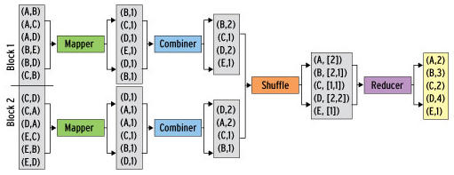
Refinement: Combiners - Example
Back to our word counting example:
Combiner combines the values of all keys of a single mapper (single machine):
Much less data needs to be copied and shuffled!

Slide 22
Map Reduce Algorithms

Slide 23
Matrix-Vector Multiplication
Suppose we have an n×n matrix M, whose element in row i and column j will be denoted m_{ij} .
Suppose we also have a vector v of length n, whose jth element is v_{j} .
Then the matrix-vector product is the vector x of length n, whose ith element x_{i} is given by
Assumption: Matrix M and vector v are stored in DFS, such that their row-column coordinates are either discoverable from file position or explicitly specified as (i, j, m_{ij}) & (j, v_{j})

Slide 24
Matrix-Vector Multiply : Case 1
Case 1: Vector v can fit in memory
Hence, vector v available to every Map task
The Map function:
Vector v is entirely read into memory of the node executing a Map task (if not already read).
Each Map task will operate on a chunk of matrix M
For each matrix element m_{ij}, Map task produces key-value pair as (i, m_{ij} * v_{j})
NOTE: All terms that will sum-up to give component of x, have same key i
The Reduce function:
It simply sums all the values associated with a given key i and generates key-value pair (i, x_{i})

Slide 25
Matrix-Vector Multiply : Case 2
Case 2: Vector v cannot fit in memory
Hence, divide the vector v into an equal sized horizontal strips. Also, divide matrix M into vertical strips, of width same as height of strips of vector v.
Division of Matrix M and vector v into five strips
Each Map task is assigned a chunk from one of the stripes of Matrix M and gets corresponding stripe of vector v.

Slide 26
Basic Relational Algebra Operations
Select:
Map function: For each t in R, test if it satisfies C. If so, produce (t,t).
Reduce function: Identity.
Project:
Map function: For each tuple t in R, construct tuple t’ by eliminating those attributes from t which are not in S. Output of Map task is key-value pair (t’, t’).
Reduce function: For each (t’, [t’, t’, t’, …]), reduce function generates (t’, t’). Thereby, it eliminates duplicates.

Slide 27
Set Operations of Relational Algebra
Union:
Map Function: Turn each input tuple t into a key-value pair (t, t).
Reduce Function: Associated with each key t there will be either one or two values. Produce output (t, t) in either case.
Intersect:
Map Function: Turn each tuple t into a key-value pair (t, t).
Reduce Function: If key t has value list [t, t], then produce (t, t). Otherwise, produce nothing.
Set Difference:
Map Function:
Reduce Function:

Slide 28
Set Operations continued…
Set Difference: Given two relations R and S, to compute set difference say (R – S).
NOTE - The Map function can pass tuples from R and S through, but must inform the Reduce function whether the tuple came from R or S.
The Map Function: For a tuple t in R, produce key-value pair (t,R), and for a tuple t in S, produce key-value pair (t, S).
Note - The intent is that the value is the name of R or S (or better, a single bit indicating whether the relation is R or S), not the entire relation.
The Reduce Function: For each key t, if the associated value list is [R], then produce (t, t). Otherwise, produce nothing.

Slide 29
Relational Algebra Operation: Natural Join
Compute the natural join R(A,B) ⋈ S(B,C)
R and S are each stored in files
Tuples are pairs (a,b) or (b,c)
A | B
a₁ | b₁
a₂ | b₁
a₃ | b₂
a₄ | b₃
B | C
b₂ | c₁
b₂ | c₂
b₃ | c₃
A | B | C
a₃ | b₂ | c₁
a₃ | b₂ | c₂
a₄ | b₃ | c₃
⋈
=
S
R

Slide 30
Map-Reduce Join
Use a hash function h from B-values to 1...k
A Map process turns:
Each input tuple R(a,b) into key-value pair (b,(a,R))
Each input tuple S(b,c) into (b,(c,S))
Map processes send each key-value pair with key b to Reduce process h(b)
Hadoop does this automatically; just tell it what k is.
Each Reduce process matches all the pairs (b,(a,R)) with all (b,(c,S)) and outputs (a,b,c).

Slide 31
Grouping and Aggregation*
select θ(B) from R group by A;
NOTE – θ is any aggregation operation such as SUM, MIN, MAX, AVG, COUNT.
The Map Function: For each tuple (a, b, c) produce the key-value pair (a, b).
The Reduce Function: Each key a represents a group. Apply the aggregation operator θ to the list [b1, b2, . . . , bn] of B-values associated with key a. The output is the pair (a, x), where x is the result of applying θ to the list.

Slide 32
Thank You

